Slide 1


<number>

Slide 2


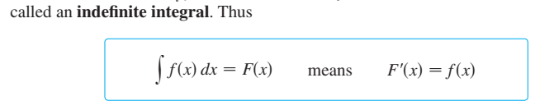
Integration
<number>

Slide 3
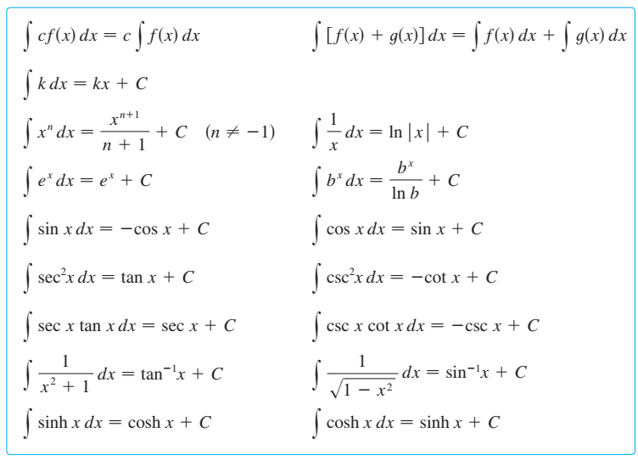
<number>

Slide 4
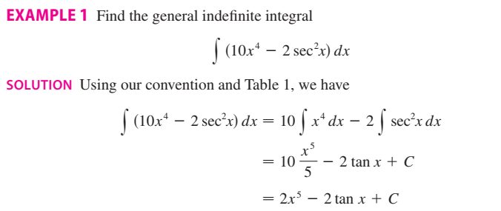
<number>

Slide 5

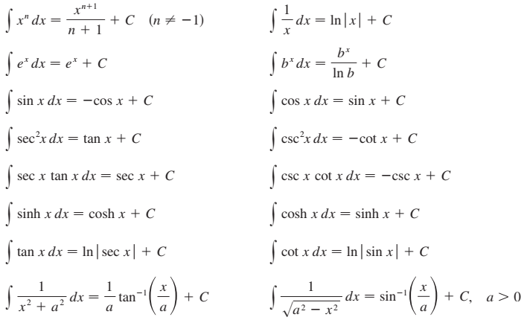
<number>

Slide 6

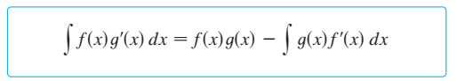
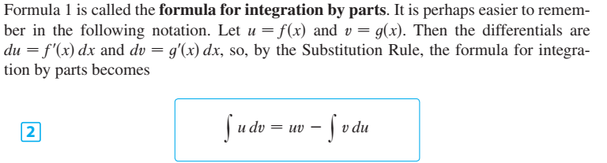
<number>

Slide 7
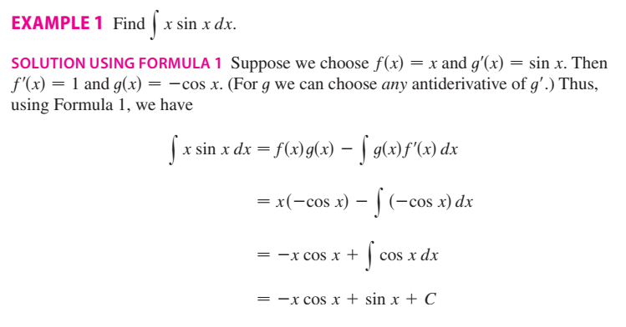
<number>

Slide 8
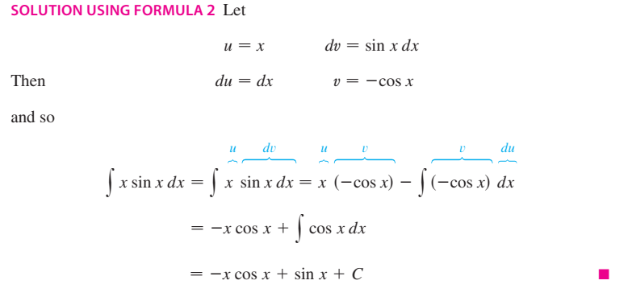
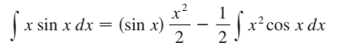
<number>

Slide 9
<number>

Slide 10
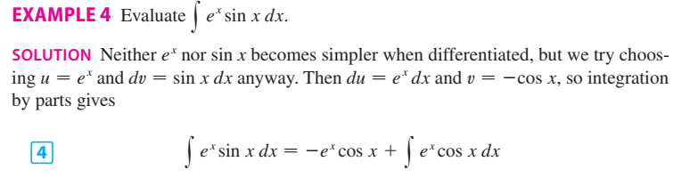
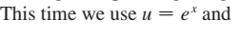
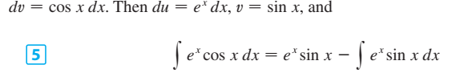
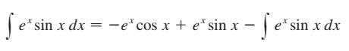
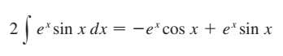
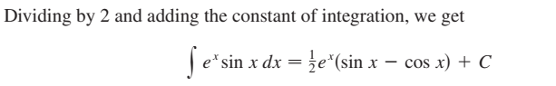
<number>

Slide 11
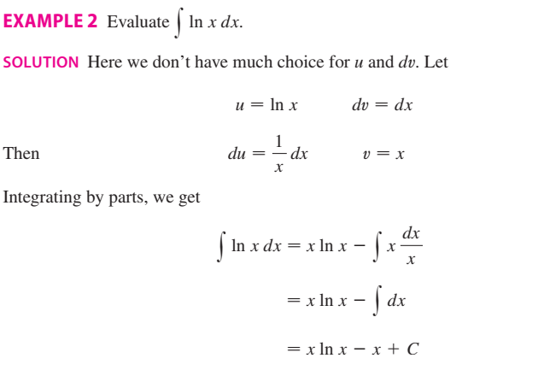
<number>

Slide 12

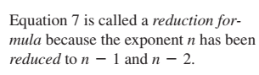
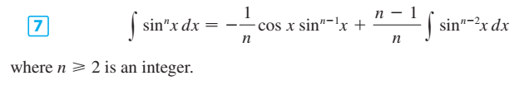
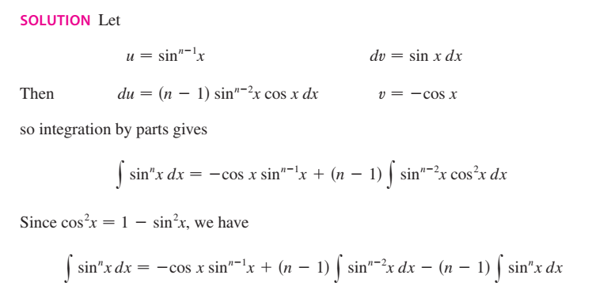
<number>

Slide 13
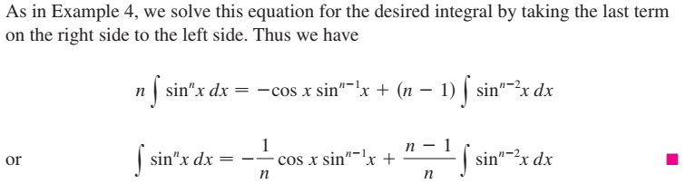
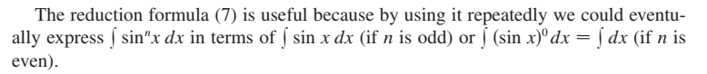
<number>

Slide 14
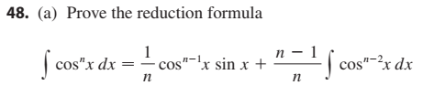
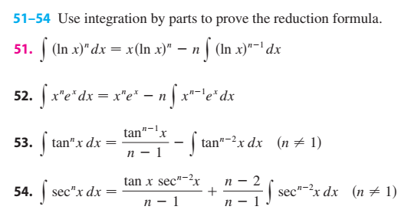
<number>

Slide 15
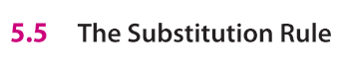
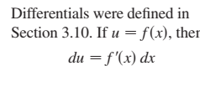
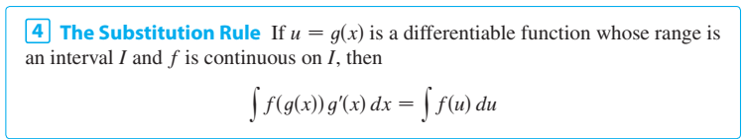
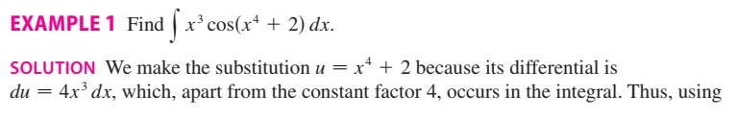
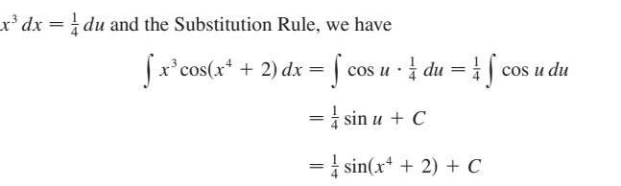
<number>

Slide 16
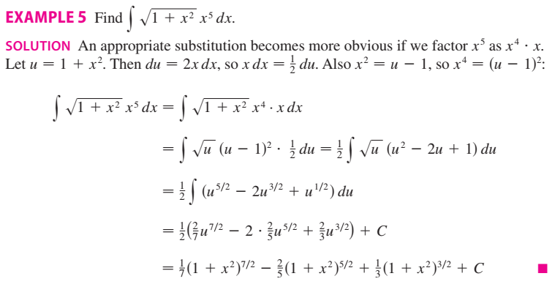
<number>

Slide 17

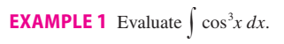
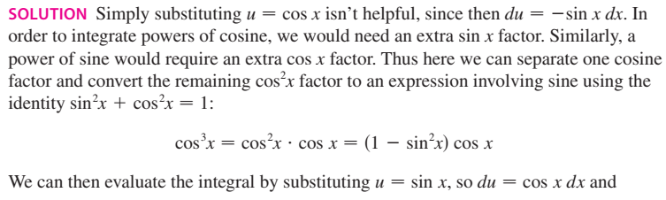
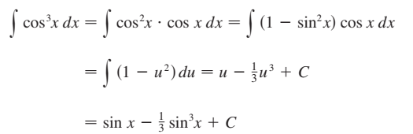
<number>

Slide 18
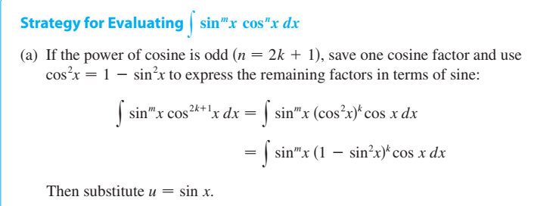
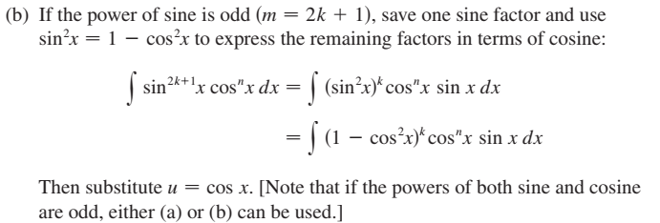
<number>

Slide 19
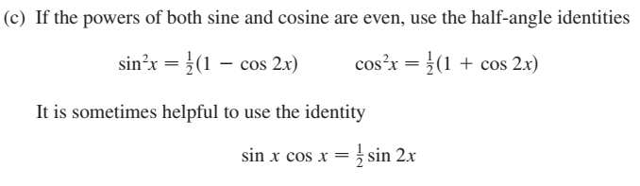
<number>

Slide 20
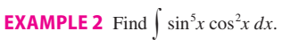
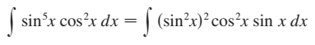
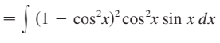
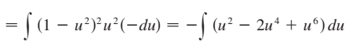
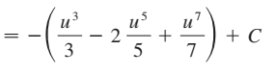
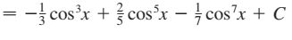
<number>

Slide 21
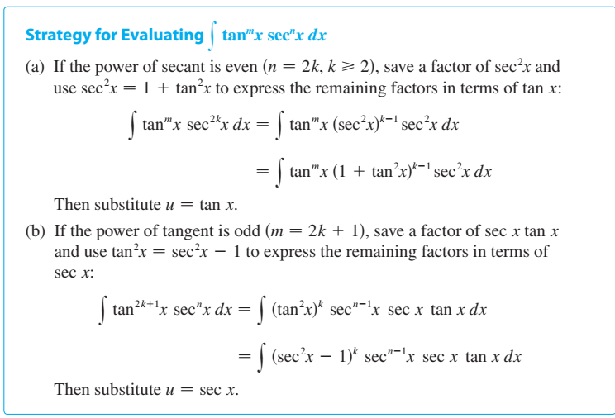
<number>

Slide 22
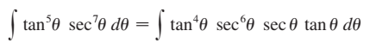
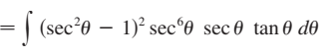
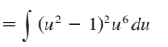
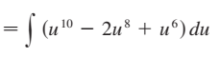
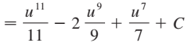
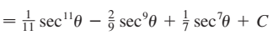
<number>

Slide 23
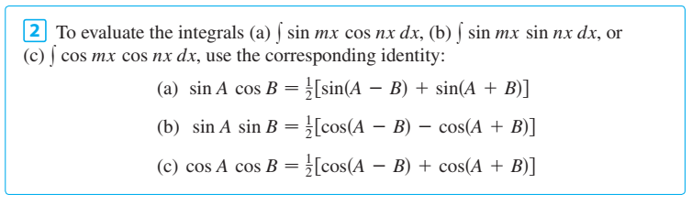
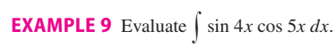



<number>

Slide 24



<number>

Slide 25







<number>

Slide 26



<number>

Slide 27




<number>

Slide 28










<number>

Slide 29








<number>

Slide 30




<number>

Slide 31





General Method
<number>

Slide 32






<number>

Slide 33



<number>

Slide 34



<number>

Slide 35






<number>

Slide 36




<number>

Slide 37




<number>

Slide 38





<number>

Slide 39



<number>

Slide 40




<number>

Slide 41





<number>

Slide 42



<number>

Slide 43



<number>

Slide 44




<number>

Slide 45




<number>

Slide 46



<number>

Slide 47




<number>

Slide 48


<number>

Slide 49

<number>

Slide 50


<number>

Slide 51


<number>

Slide 52


<number>

Slide 53

<number>

Slide 54


<number>

Slide 55



<number>

Slide 56

<number>

Slide 57


Reimann sum and Definite integrals
<number>

Slide 58

<number>

Slide 59


<number>

Slide 60


<number>

Slide 61


<number>

Slide 62



<number>

Slide 63



<number>

Slide 64




<number>

Slide 65



<number>

Slide 66




<number>

Slide 67

<number>

Slide 68



<number>

Slide 69


<number>

Slide 70



<number>

Slide 71


<number>

Slide 72




<number>

Slide 73


<number>

Slide 74


<number>

Slide 75


<number>

Slide 76



<number>

Slide 77


<number>

Slide 78



<number>

Slide 79

<number>

Slide 80


<number>

Slide 81



<number>

Slide 82

<number>

Slide 83


<number>

Slide 84



<number>

Slide 85


<number>

Slide 86


<number>

Slide 87


<number>

Slide 88



<number>

Slide 89


<number>

Slide 90



<number>

Slide 91



<number>

Slide 92


<number>

Slide 93



<number>

Slide 94


<number>

Slide 95





<number>

Slide 96


<number>

Slide 97




<number>

Slide 98



<number>

Slide 99




<number>

Slide 100





<number>

Slide 101



<number>

Slide 102


<number>

Slide 103




<number>

Slide 104




<number>

Slide 105


<number>

Slide 106


<number>

Slide 107



<number>

Slide 108

<number>

Slide 109

<number>

Slide 110


<number>

Slide 111



<number>

Slide 112




<number>

Slide 113



<number>

Slide 114

<number>

Slide 115


<number>

Slide 116




<number>

Slide 117


<number>

Slide 118


<number>

Slide 119


<number>

Slide 120


<number>

Slide 121


<number>

Slide 122

<number>

Slide 123

<number>

Slide 124




<number>

Slide 125




<number>

Slide 126



<number>

Slide 127


<number>

Slide 128


<number>

Slide 129

<number>

Slide 130


<number>

Slide 131

<number>

Slide 132


<number>

Slide 133


<number>

Slide 134
The End
<number>

